Slide 1

Co-creative Mobile Services in Agriculture
Andreas Dengel

Slide 2
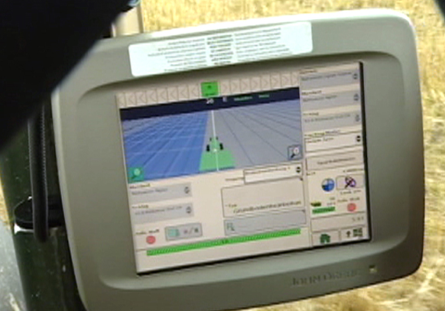
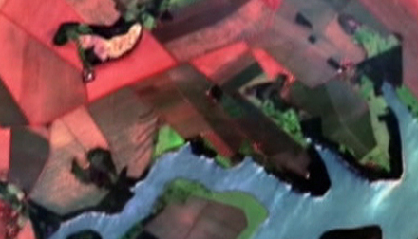
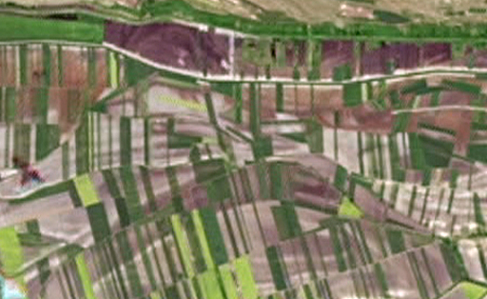
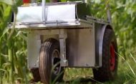
IT can help to improve and economize methods, procedures and agricultural technologies to produce more efficiently and save resources
Precision farming:
Linked and controlled by GPS, seed, fertilizer and pesticides are yielded exactly where they are needed
Digital soil quality maps: Continuous measure lead to updated guidelines helping to plan the supply of nutrients or predict harvest
Analysis of high-resolution images from space: Controlled specialized satellites take pictures of agricultural region all over the world
Field robots will take over some agricultural tasks: Equipped vehicles (not only for harvesting) are staffed with sensors to measure the state of crop and soil
Notes:
All machines are digitally linked and controlled by GPS. The farmer has real-time access to all kinds of collected data, and a logistic planer helps to save resources, e.g. by optimizing driving distances
(c) All machines are digitally linked and controlled by GPS. The farmer has real-time access to all kinds of collected data, and a logistic planer helps to save resources, e.g. by optimizing driving distancesDas Unternehmen RapidEye aus Brandenburg an der Havel hat dafür fünf Minisatelliten in den Orbit gebracht.
Aus 630 Kilometern Höhe machen sie hochauflösende Bilder von unserem Planeten. Bei Bedarf können sie sogar jeden beliebigen Punkt der Erde täglich ansteuern.
Aufnahmen haben eine Detailgenauigkeit von fünf Metern pro Bildpunkt. Das ist für Anwendungen für die Landwirtschaft ausreichend. Die Satelliten sind mit Multispektralkameras ausgerüstet. Sie erfassen die Erdoberfläche in fünf Kanälen des sichtbaren Lichts und des nahen Infrarotbereichs.
Landwirte können dadurch schnell reagieren, sie können mit ihrer Hilfe gezielter düngen und Schädlinge bekämpfen

Slide 3
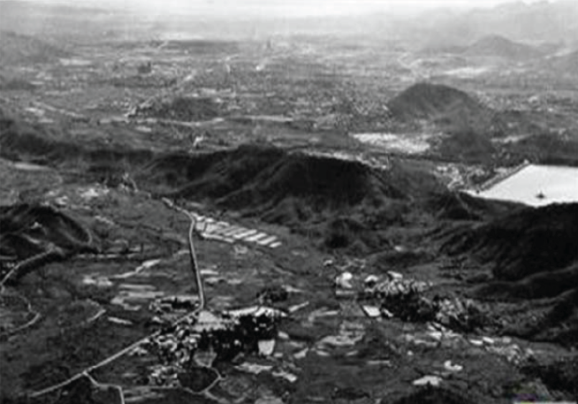
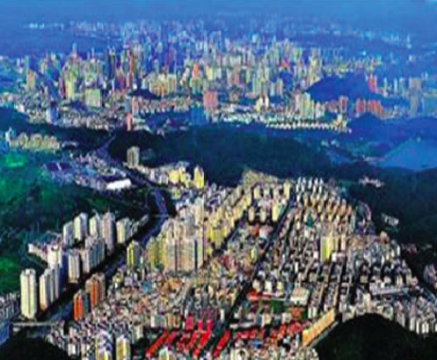
China needs to build three cities larger than Sydney every year until 2030 to accommodate rural to urban migration
Shenzhen, 1982
Shenzhen, 2007
Image sources: The Chinese UPLA urban planning network, http://www.upla.cn
Statistic derived from analysis of the United Nations, World Urbanization Prospects, The 2007 Revision Population Database

Slide 4

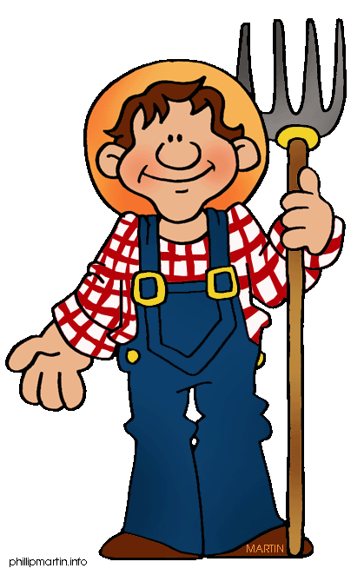
Agriculture must provide food for an extra 2 billion people but 80% of extra agricultural food can be provided only through yield increase!
9 billion people by 2050!
Extra agricultural food production
100%
≤20%
≥80%
By increasing arable land
By increasing yield
Amount of arable land in developed countries (mn hectares)
Too many factors High complexity!
World demand for cereal (bn tonnes²)
?
+43%
-0.2%
3,0
625
575
2,1
2010
2050
2010
2050
Source: (1) UN, World population to exceed 9 billion by 2050. http://www.un.org/esa/population/publications/wpp2008/pressrelease.pdf, 2013
(2) N. Alexandratos, J. Bruinsma, G. Boedeker, J. Schmidhuber, S. Broca, P. Shettym, and MG Ottaviani. World agriculture: towards 2030/2050. Interim Report. Prospects For Food, Nutrition, Agriculture and Major Commodity Groups, 2006.
Notes:
TIME: 2’

Slide 5
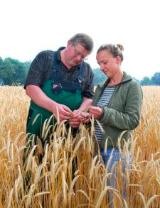
In crop production there is whole bunch of relevant questions having a space-time relationship that have to be answered for making decisions
Which kind of plant species
should we cultivate
at what location?
When should we apply what
kind of fertilizer and to which dose?
How much pesticides
should we apply at
what time?
When is the best
time for the harvest?
What market prices
may we expect?
Influencing
Factors
Private
Knowledge
Local Soil Quality
Current Crop Condition
Crop Rotation
Weather Forecast
Infestation
Degree
Market Situation
Public
Knowledge
…
Notes:
Product Featutes, Current Prices, Availability, Dosing Recommendations for seed, fertilizer, and pestizides, Sales Obtions

Slide 6

Yield depends on many factors – Experts and Decision Support Systems should help farmers optimizing yields
Ecological factors
Social factors
Yield
Soil quality
Weather condition (rainfall)
Sun exposition
Transfer of skills and roles
Security of land tenure
Access to land
?
Economical factors
Political factors
+ Ecological factors
+ Economical factors
+ Political factors
+ Social factors
+ Model(s)
________________
Optimized Yield
Fuel, fertilizers, pesticides prices
Product selling prices (Market)
…
Agricultural subventions
Quotas
Other restrictions
So how to get all of these factors combined?
Notes:
TIME: 4’

Slide 7
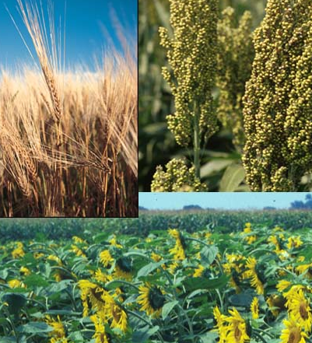
farming 4.0 strikes a new path in public-private knowledge management having a focus in agriculture
farming 4.0 is developing location-bases services and knowledge sharing networks for combining distributed, heterogeneous public as well as private information sources
- location information (i.e. maps, geo referenced orders and data) as key for knowledge management in agriculture
Built on that, we implemented mobile decision assistants using Web services for a decentralized support of
energy-efficient, economic,
environmental-adapted and collaboratively-organized
production and planning processes
There are many high-potential application fields for the platform, such as agriculture, forestry, water supply and distribution, urban development and landscaping, or nature conservation

Slide 8

Smart and Linked Data
open-up new flexibility!

Slide 9
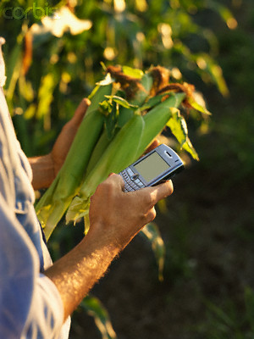
Many participants profits from effective knowledge exchange beyond the propriety formats of individual land machine manufacturers
Public Geodata are a valuable basis for location-based services
So, whats
the message?
Mobile access to data, knowledge sources, and services facilitate effective support on site
Combining public and private actors allows for comprehensive and efficient offering
e.g. improved consulting connecting public data and private services
e.g. better data via exploitation of individual sensor data
farming 4.0 develops a platform for exchanging data and services using smart and linked data technologies
i.e. intuitive understanding of data because of the availability of information about meaning and formats which is easy to be extended
i.e. service-orientation (mobile apps) for a flexible combination of a variety of services

Slide 10

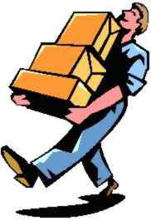
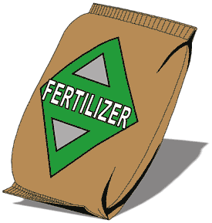







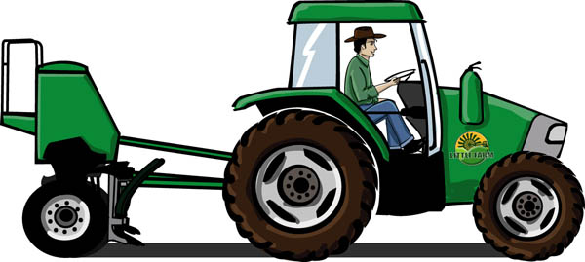
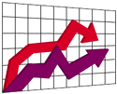
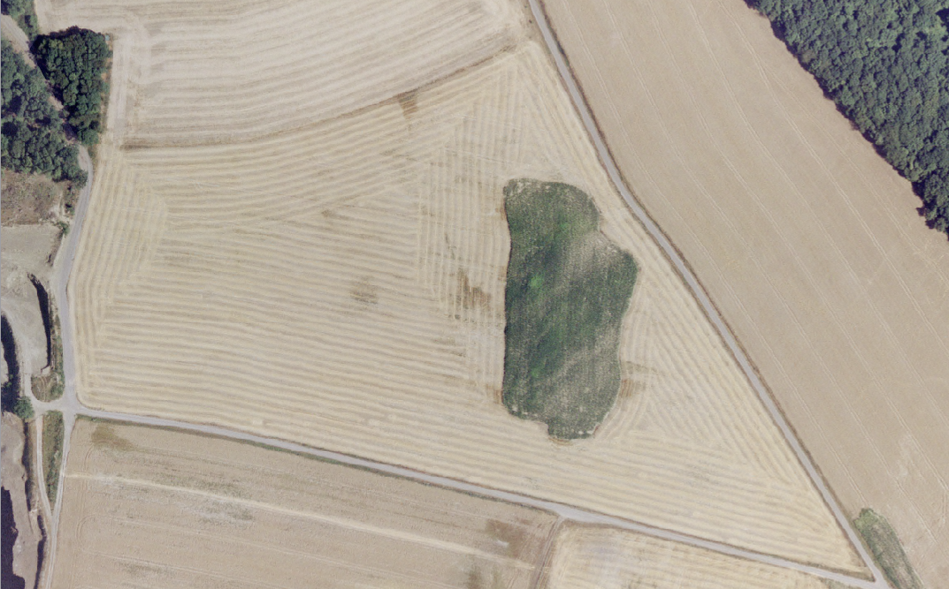
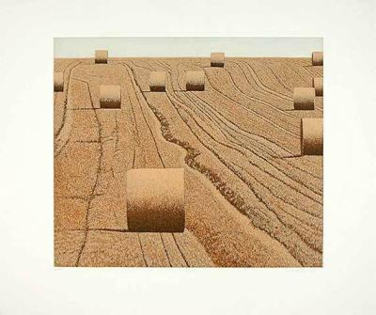
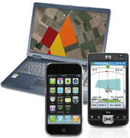
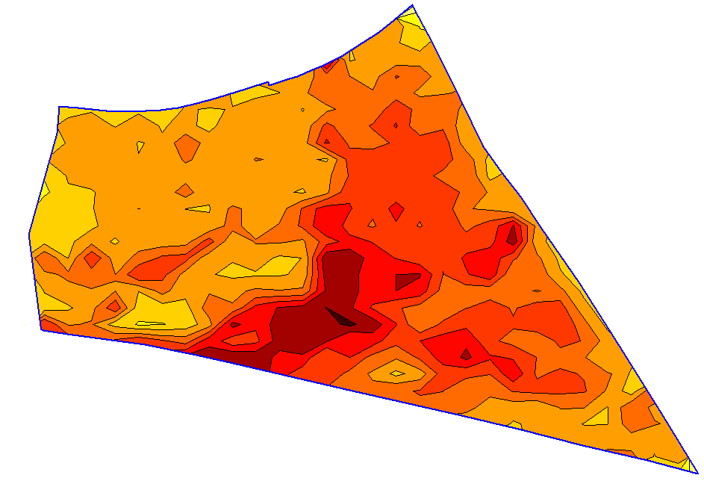
The basis of the farming 4.0 is a service-oriented open communication infrastructure for all participants employing smart and linked data technologies
Producer
Product information
Service provider
Work contracts
Job processing
Supplier
Consultation
Retail
Wheather services
Consumer
Machine
Public Geodata
Farmer
Farm DMS
Crop information
Individual data

Slide 11

So, let us consider some
results from the iGreen project

Slide 12











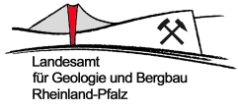










iGreen builds on an alliance of 23 partners from science, business and public institutions
Agricultural Manufacturers
Agricultural Applications, Dervices & Consultancy
IT Research & Development
1.4.2009-30.4.2013
gefördert vom
Notes:
Zentralstelle der deutschen Länder für EDV-gestützte Entscheidungshilfen und Programme im Pflanzenschutz

Slide 13


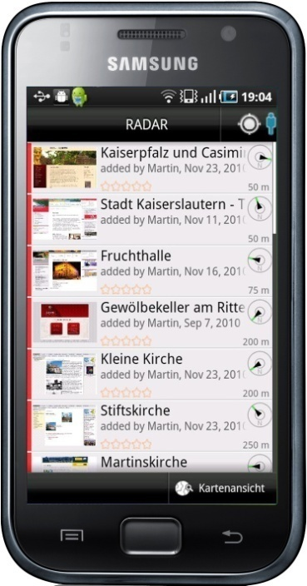


From the view of a contractor an iGreen Node provides many options
Retail
Filing
Expert
Order
Request)
Delivery Note
Map
Exchange of data
iGreen Node
iGreen Node
Exchange with colleagues
Documentation
Office of Contractor
Order
Order (incl. geo reference)
Task data
Documentation
Farm Machine
Search Servives
Evaluation Services
Visulalization Services
Farmer

Slide 14
From the view of a contractor an iGreen Node provides many options
Retail
Filing
Expert
Let‘s have a closer look how a farmer
may submit his/her geo reference data!
Order
Request)
Delivery Note
Map
Exchange of data
iGreen Node
iGreen Node
Exchange with colleagues
Documentation
Office of Contractor
Order
Order (incl. geo reference)
Task data
Documentation
Farm Machine
Search Servives
Evaluation Services
Visulalization Services
Farmer

Slide 15
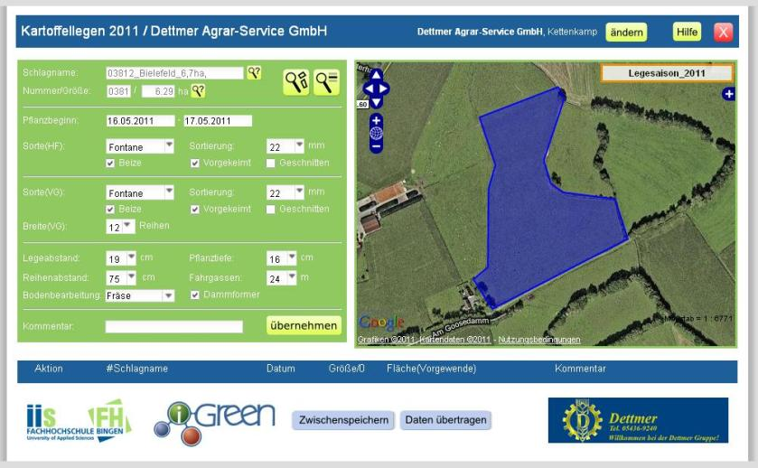
The implementation of geo forms facilitate tasks and communication
Orders are entered and transmitted via geo forms
Acre ID
This includes access to public geo data where the corresponding acre is explicitly denoted
Acre Dimensions
Planting Period
Plant Type
Planting Depth
Planting Distance
…

Slide 16
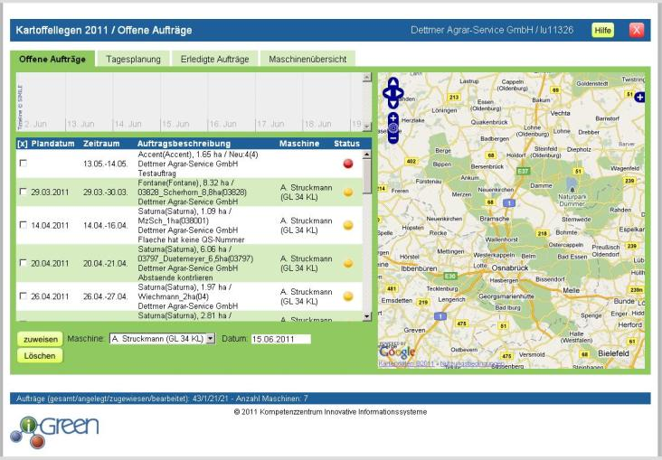
The implementation of geo forms facilitate tasks and communication
Orders are entered and transmitted via geo forms
Machine Overview
Finished Orders
This includes access to public geo data where the corresponding acre is explicitly denoted
Daily Plan
Open Orders
Status
Machine
Order Description
Period
Planned Date

Slide 17

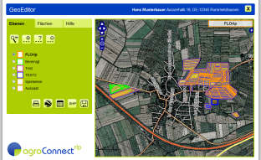
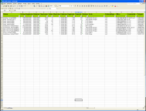
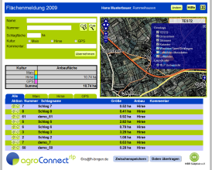
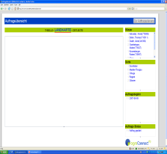
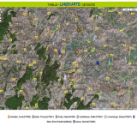


The data exchange between the services allows a end-to-end service chain
order plus geo reference
(isoXML, GML)
machine order
(isoXML)
Geo
Form
Machines
Geo
Editor
Farmer
Contractor
Acre Geometry
(GML, Shape, ?)
Driver
Maps,
InVeKoS Data
Maps,
InVeKoS Data
Public Geo Data
Public Geo Data
17
Notes:
InVeKoS (Integrated management and Control System introduced by the European Commission to rule the agricultural setting, such as the identification of agruculatural resources

Slide 18
From the view of a contractor an iGreen Node provides many options
Retail
Filing
Expert
But we may also improve the communication
on the acres using a machine connector!
Order
Request)
Delivery Note
Map
Exchange of data
iGreen Node
iGreen Node
Exchange with colleagues
Documentation
Office of Contractor
Order
Order (incl. geo reference)
Task data
Documentation
Farm Machine
Search Servives
Evaluation Services
Visulalization Services
Farmer

Slide 19
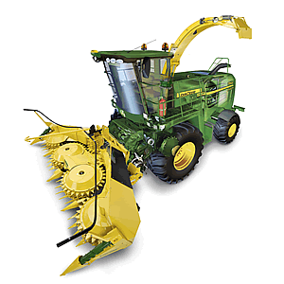
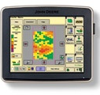
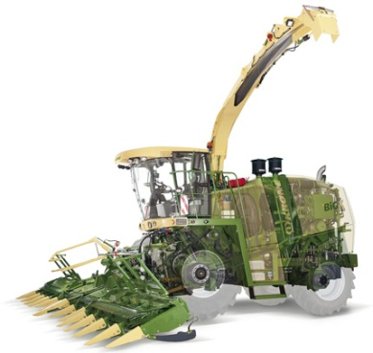
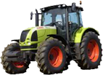
For the communication between agro-technology (e.g. machines), we have developed a specific machine connector using ISOXML
Data synchronization between machines (fleet as synchronized data space)
Data synchronization via mobile internet
Interfaces for data interchange are defined manufacturer-independent
iGreen Node
Office of Contractor
Machine and iGreen node combine ISOXML and semantic annotations
Machine Connector Gateway

Slide 20
From the view of a contractor an iGreen Node provides many options
Retail
Filing
Expert
Order
Request)
Delivery Note
Map
Exchange of data
iGreen Node
iGreen Node
Exchange with colleagues
Documentation
Office of Contractor
Order
Order (incl. geo reference)
Public-private knowledge exchange provides
better consulting services!
Task data
Documentation
Farm Machine
Search Servives
Evaluation Services
Visulalization Services
Farmer

Slide 21

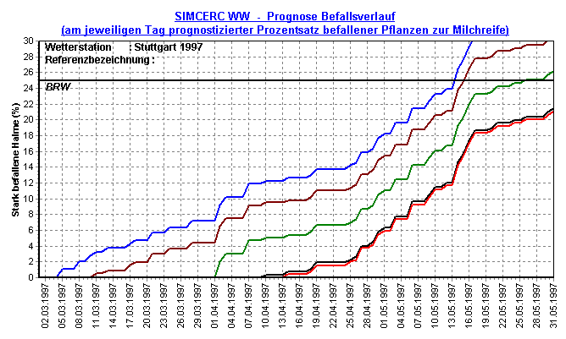

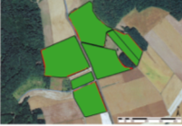
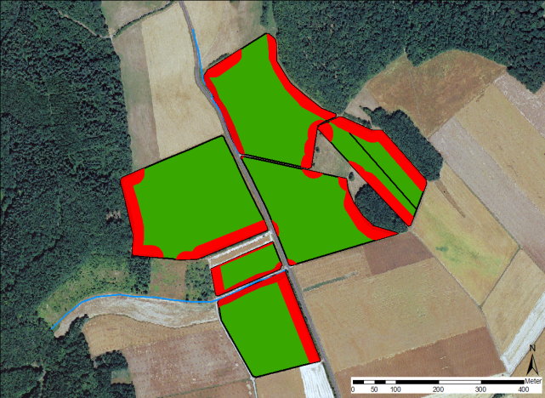
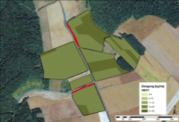

For satisfying frequent requests from farmers, iGreen provides an application assistant for pest management
When should a pesticide application take place?
Where on the acre should the pesticide be applied and to which objects should I keep a certain distance?
Which locations on the acre are sensitive to be infected?
Consultancy Request
Pest
Prognoses
Field Boundaries
Application Technique
Pesticide
Distance
Calculation
Application Map
Management
Zone
Advising

Slide 22
Scenario planning allows
crop forecast

Slide 23
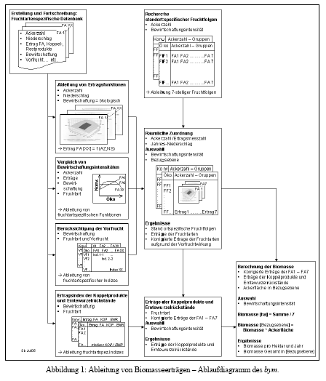
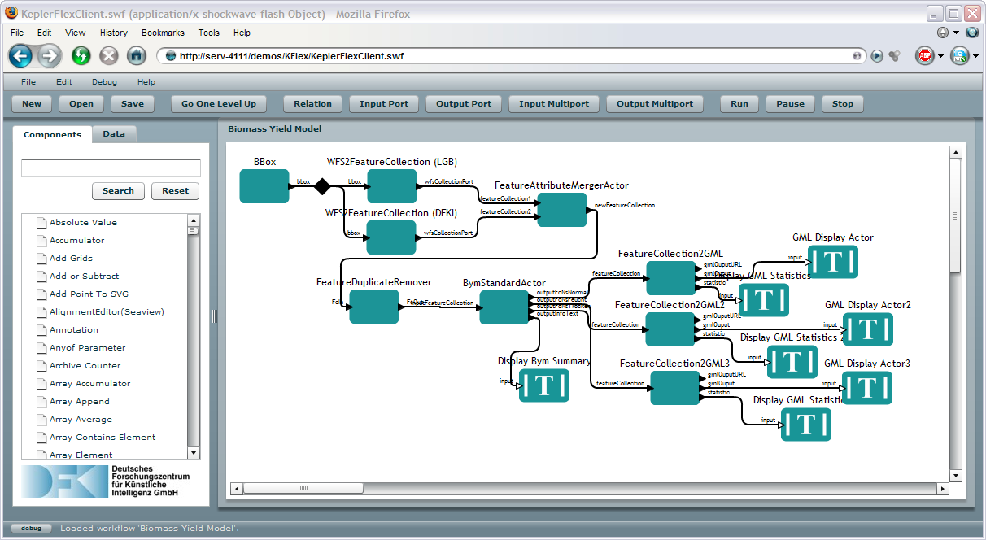
Tasks and their dependencies of Biomass-Yield-Models (BYM) are transformed into a scientific workflow
Computational steps for scientific simulations or data-analysis steps
Advantages of scientific workflows:
Data flow approach based on visual programming
Modularity and reusability
Provenance information to better interpret results and debug errors
Source: B. Ludäscher, I. Altintas, C. Berkley, D. Higgins, E. Jaeger, M. Jones, E.A. Lee, J. Tao, and Y. Zhao. Scientific workflow management and the Kepler system: Research articles.
Concurr. Comput. : Pract. Exper., 18:1039-1065, August 2006. ISSN 1532-0626. doi: 10.1002/cpe.v18:10.
Notes:
23

Slide 24



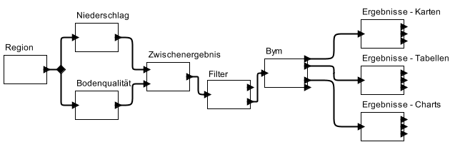
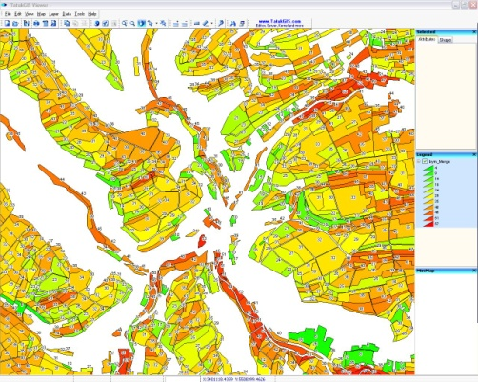

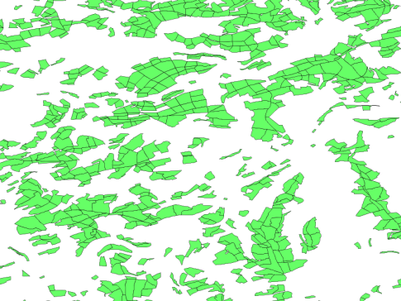


Based on various public sources we have developed a Crop Forecast System aiming at supporting the farmer in making decisions
Pre-given Goal
Crop Forecast
Rain
Result Map
Region
Intermediate
Result
BYM
Result Table
Filter
Soil Quality
Result Chart
Agricltural Crop Land Online
Rheinland-Pfalz (FLOrlp)
Biomass
Yield
Models
(BYM)
Soil Quality Data
* Zentralstelle der Länder für EDV-gestützte Entscheidungshilfen
und Programme im Pflanzenschutz

Slide 25
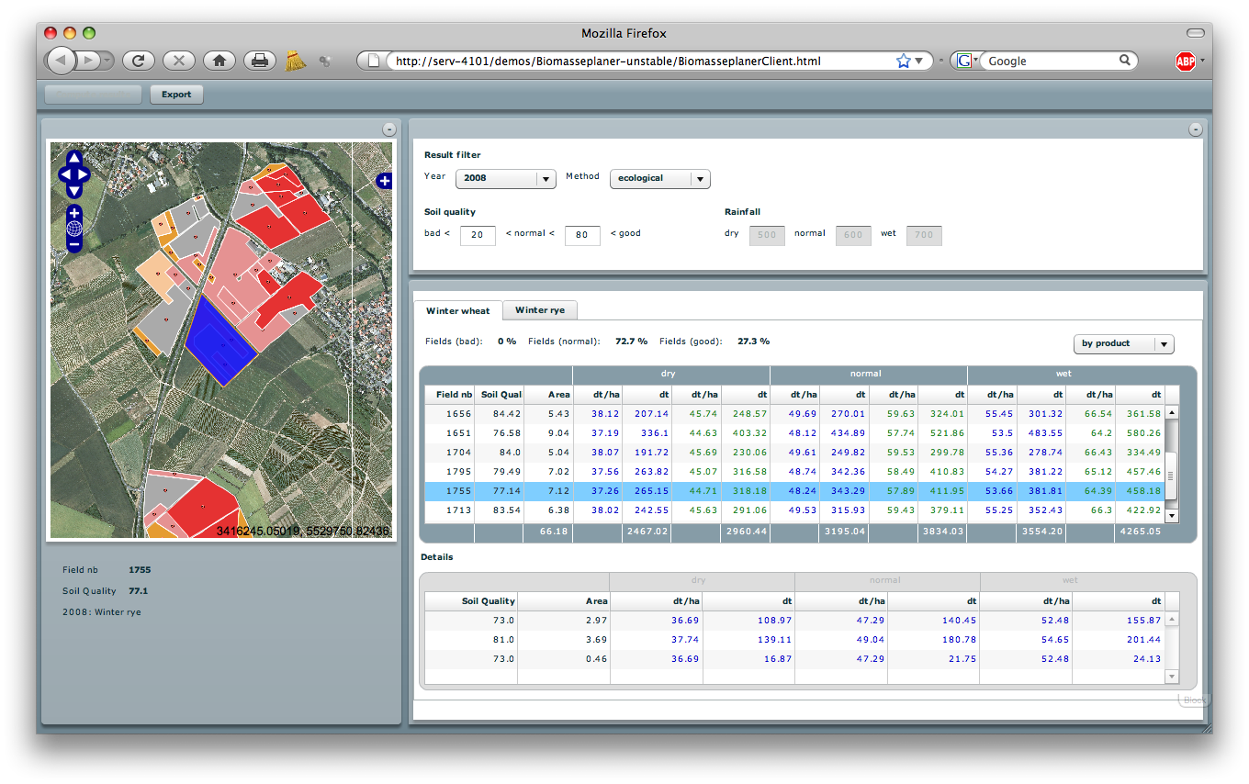
A Mashup of maps and tabular information provides a intuitive platform for biomass planning
Excel and Google Earth export
Ecological or conventional yield
3 rainfall scenarios (dry, normal, wet)
Results for fields
Results for subfields
Notes:
Mash-up OpenLayers mit AdobeFlash
Computes the yield based on the farm documentation and a given crop rotation (crop rotation is defined using our crop rotation editor)
Computes yield for ecological and conventional exploitation
3 rainfall scenarios (dry, normal and wet)
Yield is computed on both field and subfield level
Export functionality to Excel and Google Earth
Interaction between map and tables

Slide 26
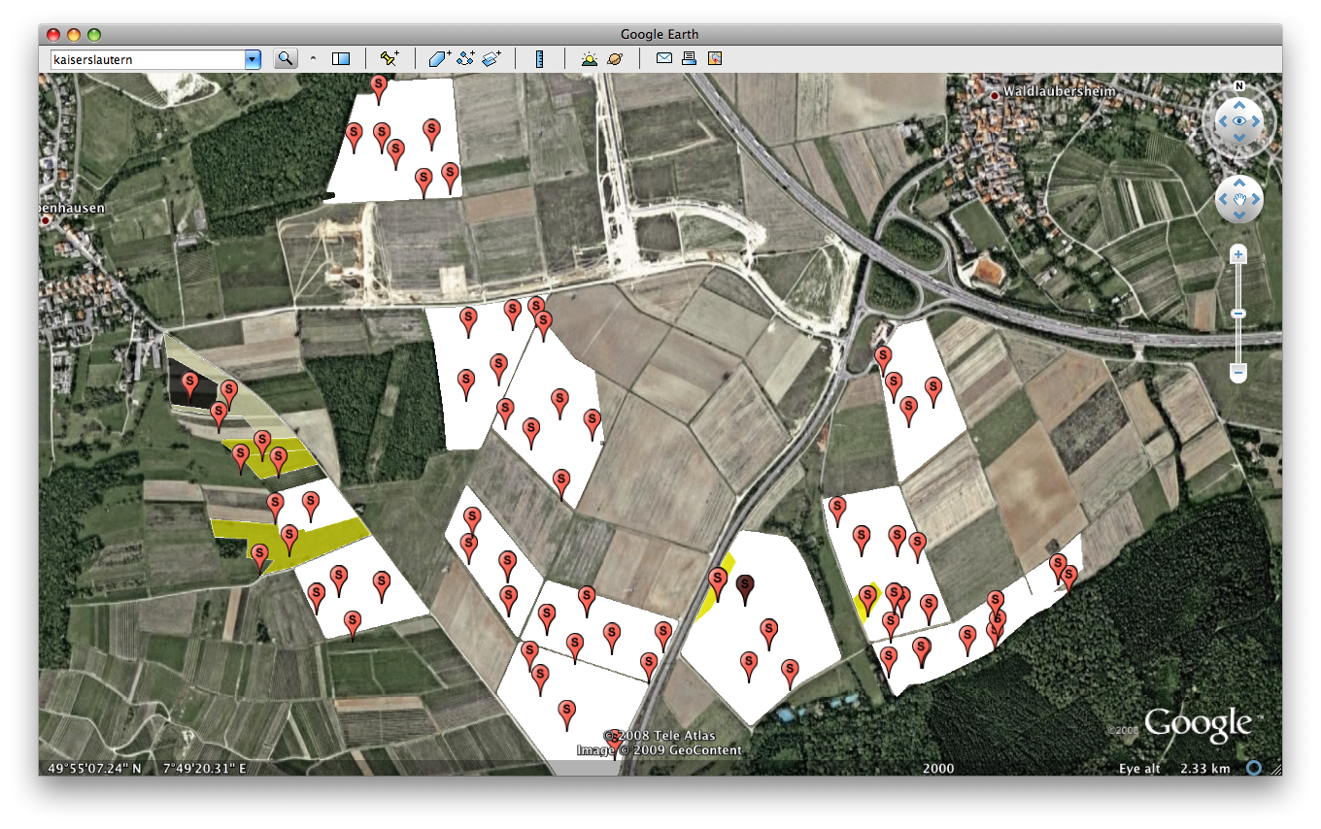
In Google Earth subfield-related information may be accessed via any mobile device

Slide 27
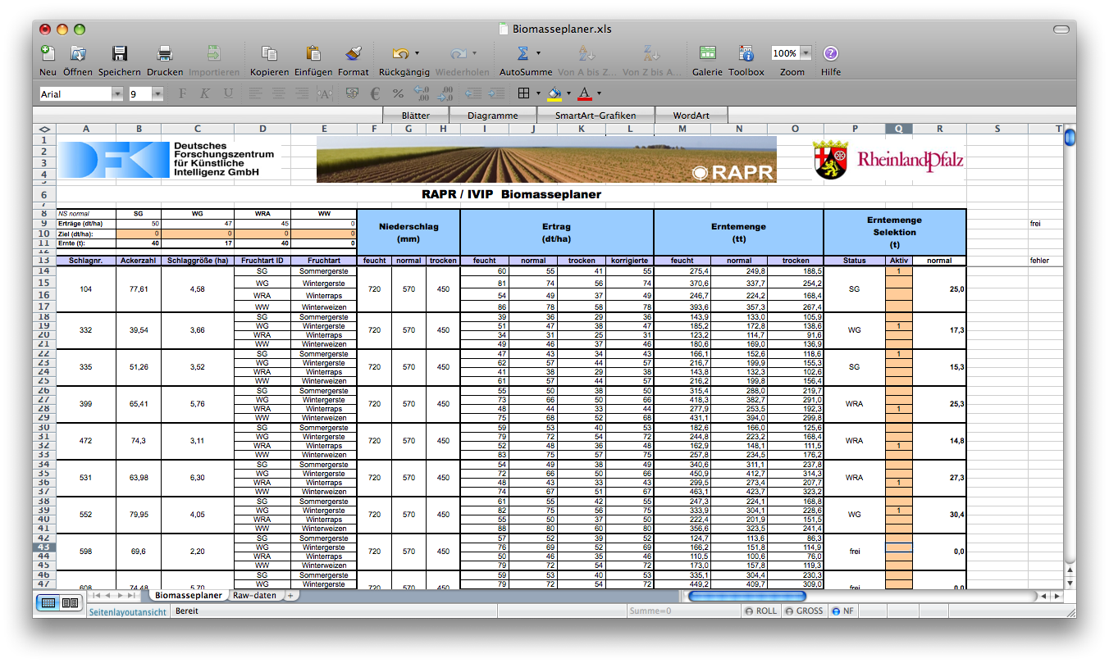
Exporting the information to an Excel spreadsheet (with Macros) supports realizing a production plan

Slide 28
We have tested the forecast on a farm by evaluating four tours*
Biomass (t)
-15%
One field not be harvested
Weed infestations
-2%
-3%
-19%
Tour 1
Tour 2
Tour 3
Tour 4
Forecast
Real
* 16 fields to be harvested; avg. dist. betw. field and silo: 9.5 km; average exploitable acreage: 2.44 ha
Notes:
- Mockup showing what we want to achieve

Slide 29
Existing soil quality maps
may be improved

Slide 30
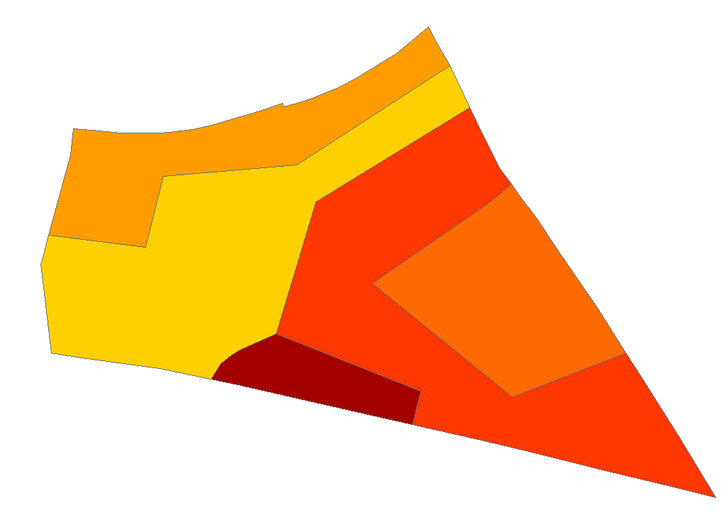
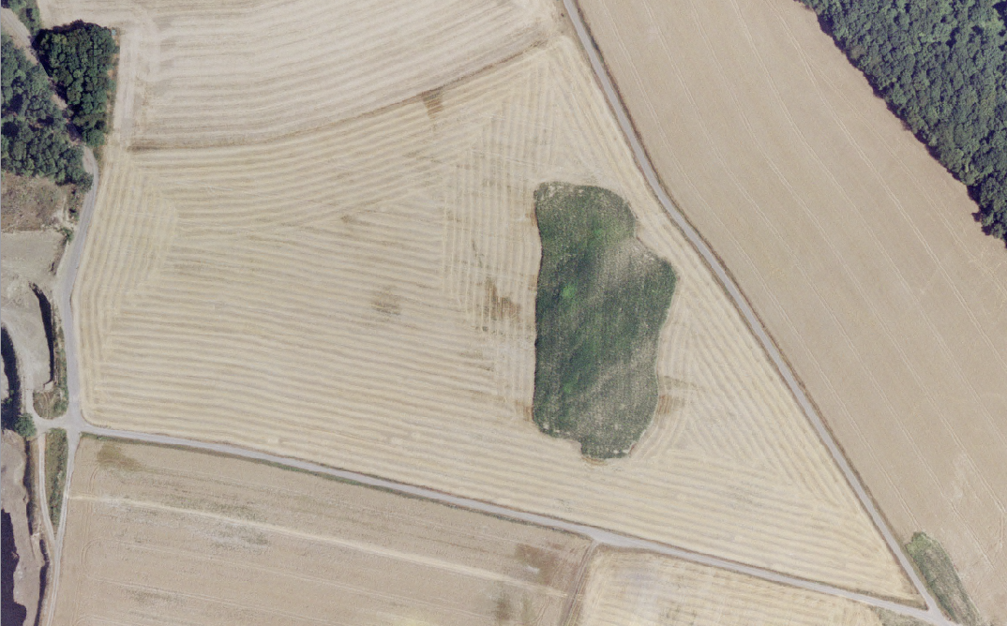
Digital soil quality maps provided by state government allow farmers to get an overview about the quality of their fields
40
Additional information may be accessed via the lot No.
33
44
61
53

Slide 31
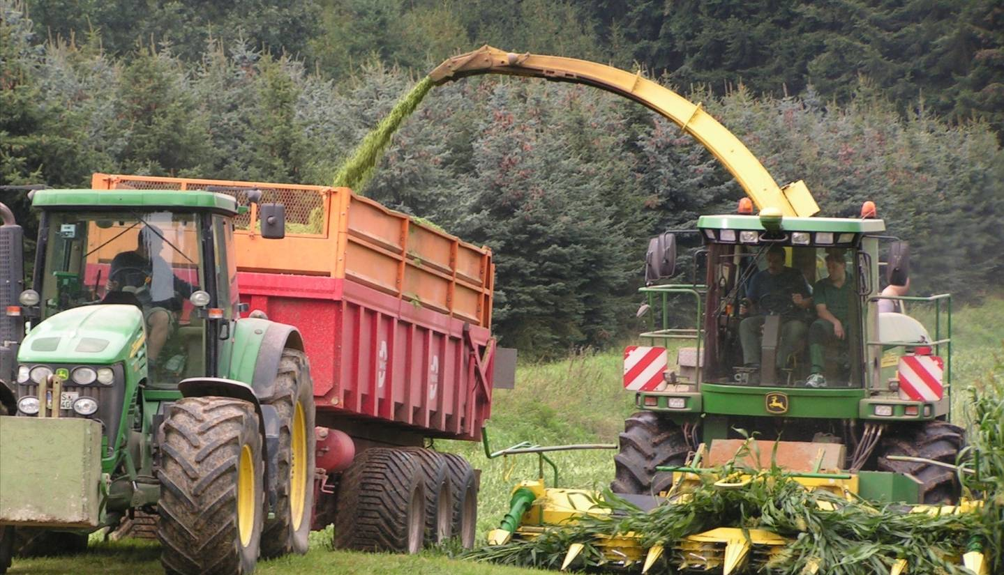
Agricultural engineering provides relevant location-based data
Humidity Sensor
Recording of location, crop, humidity, and fuel consumption:
Melt Flow Sensor

Slide 32
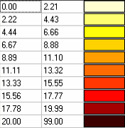
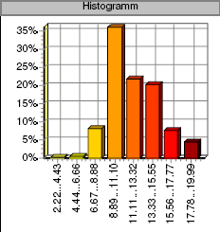
Location-based recording of crop data leads to an up-date of soil quality maps
Recorded on 29-09-2008 Average Value 12,23 t/ha
Try Solids 100,40 t Humidity 73,55 %
CROP (t/ha)
from
to
HISTOGRAM

Slide 33
Logistic planning allows
to remarkably save fuel

Slide 34
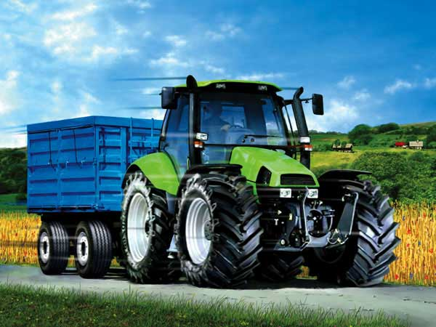
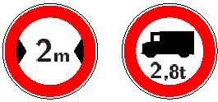

Current available route guidance systems do not provide information about road narrowing nor bridge weights limits

Slide 35

This way, we also developed a first collaborative open-source routing system for utilities vehicles (CRUV)
Vehicle type (car, lorry, tractor)
Road types: Motorway, highway,
country road, field path with priorities
(preferred, normal, avoid, forbidden)
Tunnels and bridges with priorities
Vehicle length, weight, height, width
Rules based on user meta-information stored in Open Street Maps
Notes:
- Route planer using collaborative user meta-information stored in Open-Street-Map

Slide 36


Compared to Map24, there is no difference in quality in traditional route planning
CRUV: 186 km
Map24: 186 km

Slide 37

However, CRUV reveals its advantages when including the additional information, e.g. with bridges and maximal weight allowed
Google Maps does not support the kind of query!
GoogleMaps: 1,5 km
CRUV: 2,8 km

Slide 38

A logistic planer computes transportation costs based on the results from the CRUV and biomass planner
Overview with Biomass and costs
Field repartition with respect to the driving distance
Max. driving distance d between field and POI
List of Fields (< d):
Size
Driving distance
Crop
Yield
Transportation costs
Point of interest (ex: Biogas plant)
Slope (of the road)
Route between POI based on driving distance
Notes:
- Mockup showing what we want to achieve

Slide 39
We have tested the forecast on a farm by evaluating four tours*
Biomass (t)
Transportation costs (EUR)
One field not be harvested
+4%
Higher fuel consumption due to dry soil
-15%
Weed infestations
+57%
-2%
-3%
+8%
-3%
-19%
Tour 1
Tour 2
Tour 3
Tour 4
Tour 1
Tour 2
Tour 3
Tour 4
Forecast
Real
Forecast
Real
* 16 fields to be harvested; avg. dist. betw. field and silo: 9.5 km; average exploitable acreage: 2.44 ha
Notes:
- Mockup showing what we want to achieve

Slide 40
From the view of a contractor an iGreen Node provides many options
Retail
Filing
Expert
Order
Request)
Delivery Note
Map
Exchange of data
iGreen Node
iGreen Node
Semantically enriched data
allows flexible evaluation!
Exchange with colleagues
Documentation
Office of Contractor
Order
Order (incl. geo reference)
Task data
Documentation
Farm Machine
Search Servives
Evaluation Services
Visulalization Services
Farmer

Slide 41


Contractors may generate application reports “on-demand”
Metadata (when, who, where)
Budgets
Field with its geo location
Persons
Farms
Fields
Seeds
Machines
Tasks
More Views:
Explicitly denoted concepts (Semantic Browsing)

Slide 42
Let‘s summarize!

Slide 43

Decision support in crop production provides important contributions for increasing efficiency, saving resources, and reducing environmental impact
Exemplary result (10 farmers in the north of the German state Rhineland-Palatinate):
Winter wheat is the most important crop in Germany having a total acreage of 3 Mio hectares. Experts estimate that each hectare of winter wheat requires about 200 kg of nitrate per year. Nitrate production causes about 50% of energy consumption in crop production
Using location-adaptive fertilizer dispersion for wheat production based on improved soil quality maps , it was possible to save ca. 5% of nitrates without reducing the amount of crop
The German agriculture may …
... lead to possible energy saving potential of 30.000 tons of nitrate per year
... avoid climate-relevant emissions of 257,000 tons of CO² annually
... reduces the amount of nitrate-containing nutriments in bodies of water

Slide 44

The goals of farming 4.0 are very relevant for many social systems
Food production is not a task just of agriculture, but a central aim of the global society
In case of crisis, food security has to be guaranteed by both, federal and private organizations (this is part of the food precaution law and food ensuring law in Germany)
farming 4.0 use cases and demonstrators prove the new options based on real application scenarios
farming 4.0 SDK provides general and fundamental components as open source
farming 4.0 documents (processes, scenarios, interfaces) provide excellent guidelines, e.g. who communicates with whom ,why, and with what tools
Long-term Public-Private Partnerships are of major importance

Slide 45


Thank you, questions are welcome!
Address:
Prof. Dr. Prof. h.c. Andreas Dengel
DFKI GmbH
P.O. Box 2080
D-67608 Kaiserslautern
email: andreas.dengel@dfki.de
http://www.dfki.de/~dengel
Notes:
Dieses Zitat stammt, entgegen dem ersten Eindruck, nur in seinem ersten Teil aus der Feder von Wilhelm Busch (Max und Moritz). Der zweite Satz ist kreativ angefügt, vielleicht von den Grafikern dieser Briefmarke? Gleichwohl trifft er, was die Homöopathie betrifft, ins Schwarze
45

